Slide 1
Backpropagation XOR

Slide 2
Setup
Two perceptrons in the hidden layer
One output perceptron
Two inputs
Weights are generated randomely
Sigmoid AF
Shuffleing of the array
Lenght of data array 1000 for training
Maximum nr. of epochs 10000
Testing with 4 different inputs a 1000 times

Slide 3
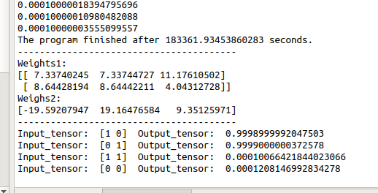
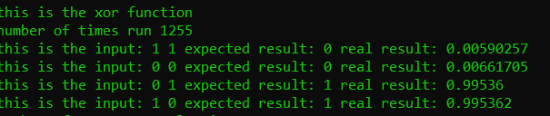
Results
With the sigmoid it would never reach exactly 1.
C++ code stopped after reaching an error of 0.000001 with a learning a rate of 0.1.
Python stopped after reaching an error of 0.0001.
Needs a check, to see if it in some tolerance to 1, to compare to the correct result.

Slide 4
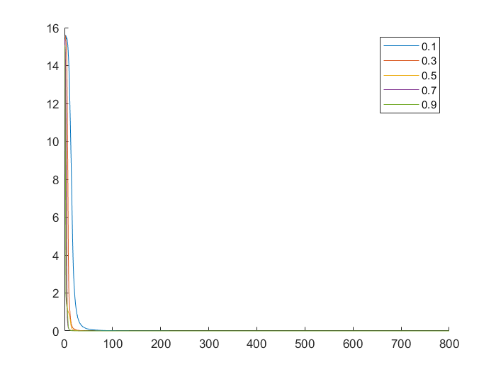
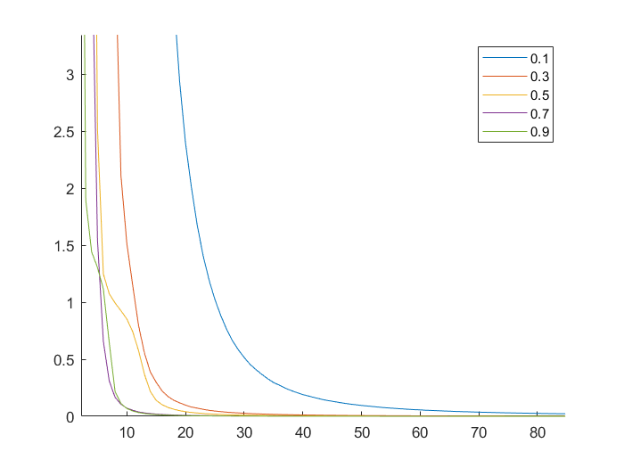
Results
Different learning rates
Sum of squared errors pr. epoch
0.1 : 8788 epochs
0.3 : 2912 epochs
0.5 : 1750 epochs
0.7 : 1272 epochs
0.9 : 986 epochs

Slide 5
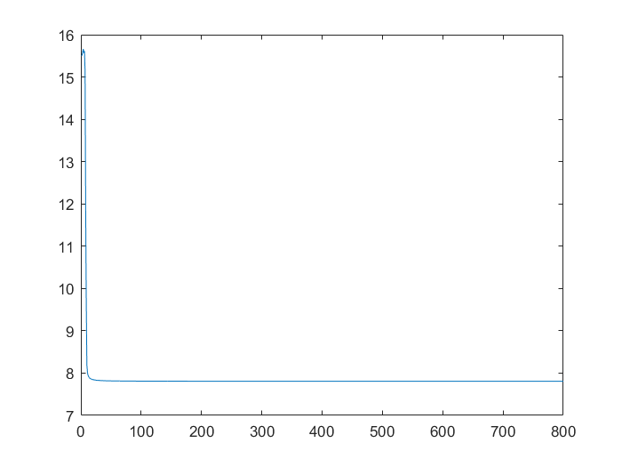
Conclusion
It was possible to teach a multilayer peceptron system to categorize the XOR-problem.
Due to the random generation of weights it will sometimes get stuck on a local minimum and therefore fails the training session.
Higher learning rate makes it learn faster.
Maybe TLU AF would have been better, due to the inputs
Plot of error stuck at a local minimum

